Slide 1
Fuel comparisons – remaining presentations?
Reports on these molecule comparisons:
2,2,4-Trimethylpentane vs n-octane
cyclooctane vs n-octane
ethanol vs methanol
ethanol vs propanol
glycerol vs 1,2-Propanediol
D-glucose vs fructose
2. I’ll report on these:
decanoic acid vs methyl decanoate
glycerol vs glyceryl tristearate
How are they similar/different?
Number of carbon atoms
H–to–C atom ratio
Straight or branched?

Slide 2
Where we left off last time
Forms of fossil fuels (coal, oil, gas)
How we make electricity from burning fossil fuels (or anything else)
What burning has to do with chemical bonds
How we refine the oil we extract from the ground (for burning, and also to make plastics)
How we extract fossil fuels from the ground

Slide 3
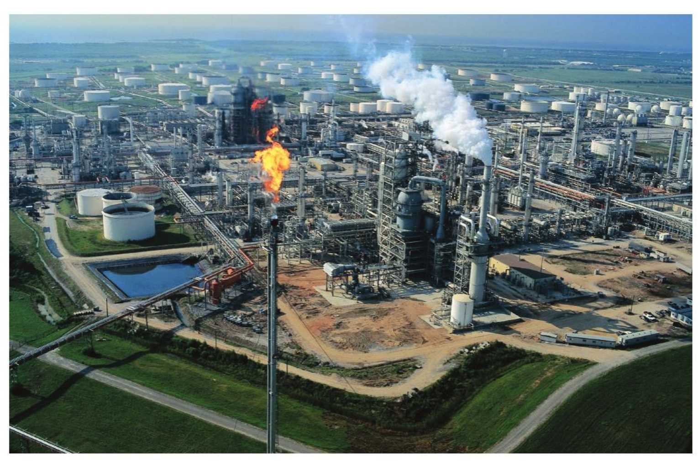
Refining of crude oil

Slide 4
Piped in and sent to distillation towers

Slide 5
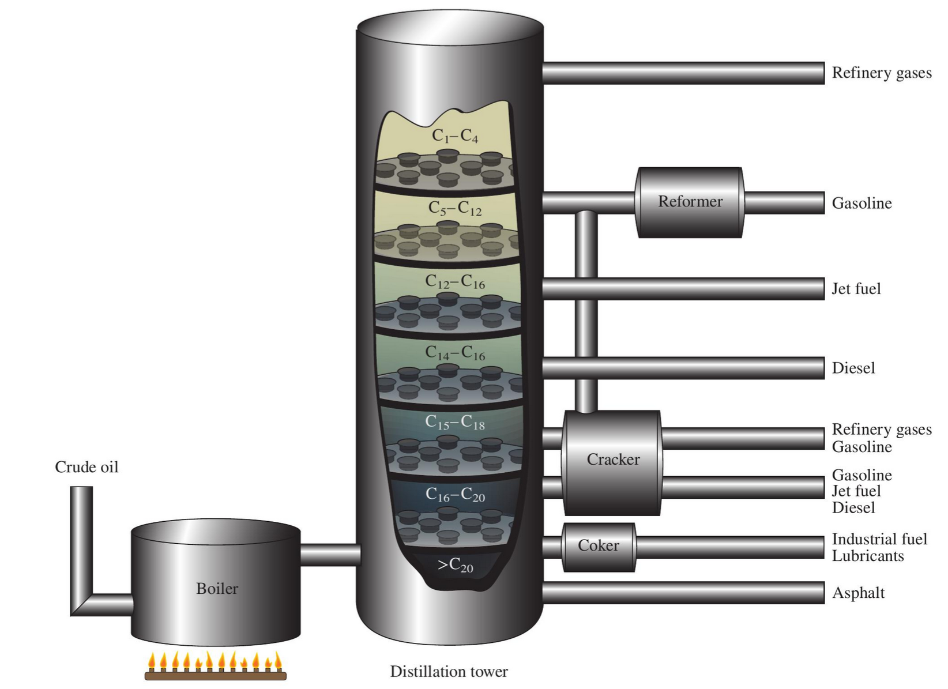
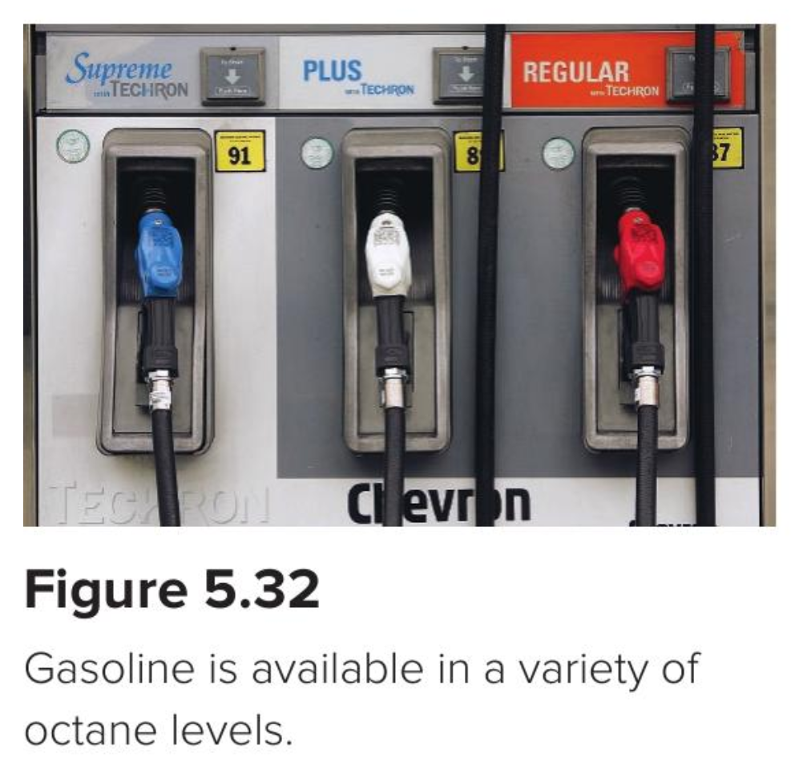
What’s a distillation tower?
More volatile components rise higher

Slide 6
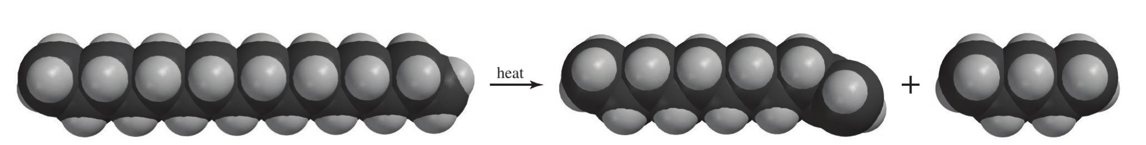
We can even bust up (“crack”) longer hydrocarbons to make them more useful
C₁₆
Solid at room temperature
C₁₁
Liquid at room temperature
C₅
Liquid at room temperature

Slide 7
Roadmap for today
Forms of fossil fuels (coal, oil, gas)
How we make electricity from burning fossil fuels (or anything else)
What burning has to do with chemical bonds
How we refine the oil we extract from the ground (for burning, and also to make plastics)
How we extract fossil fuels from the ground

Slide 8
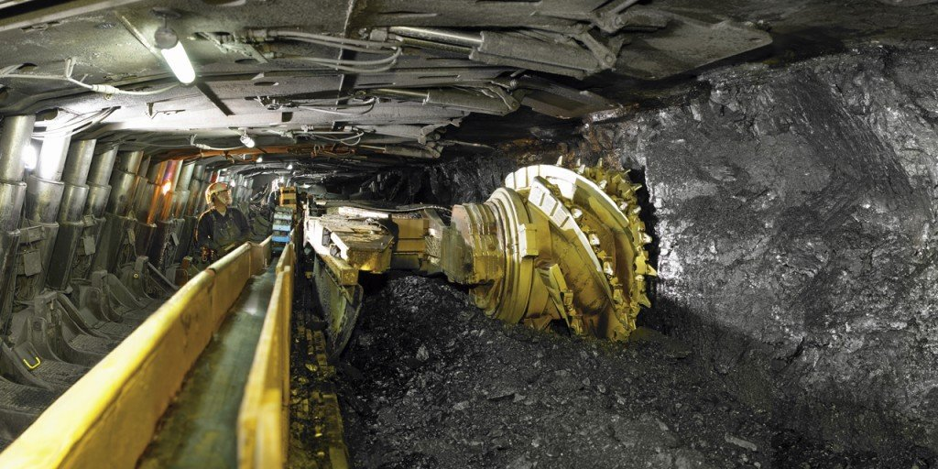
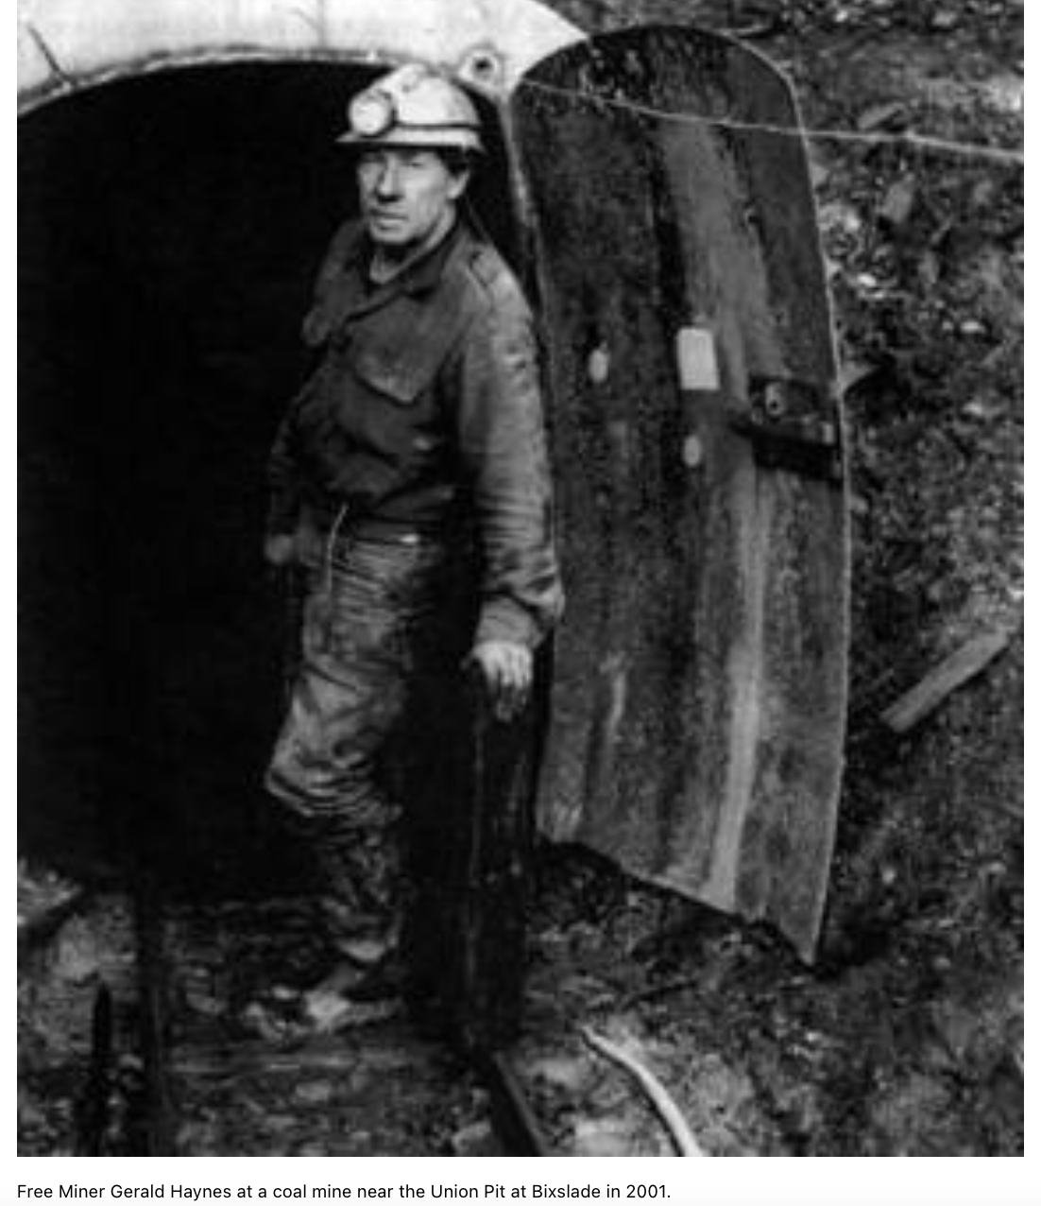
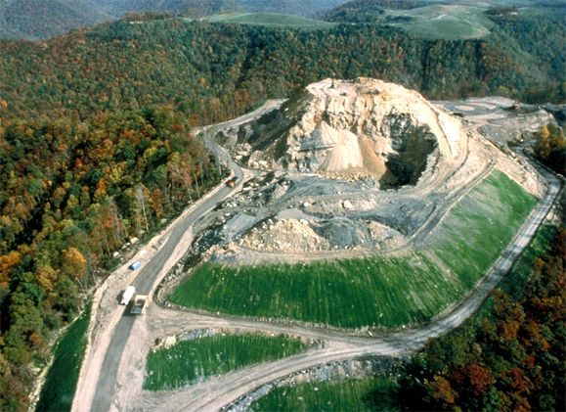
How to get it out of the ground: Coal Mining

Slide 9
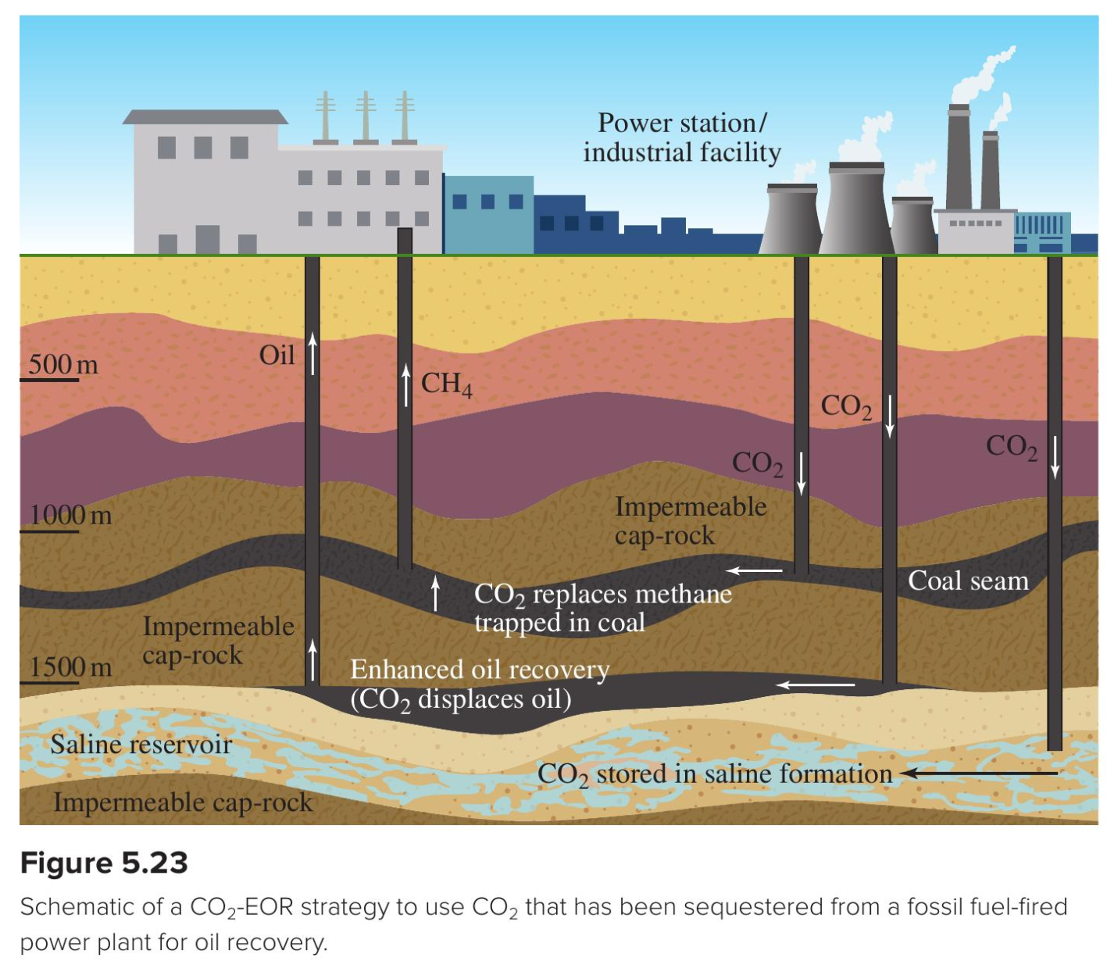
How to get it out of the ground: Enhanced Oil Recovery

Slide 10
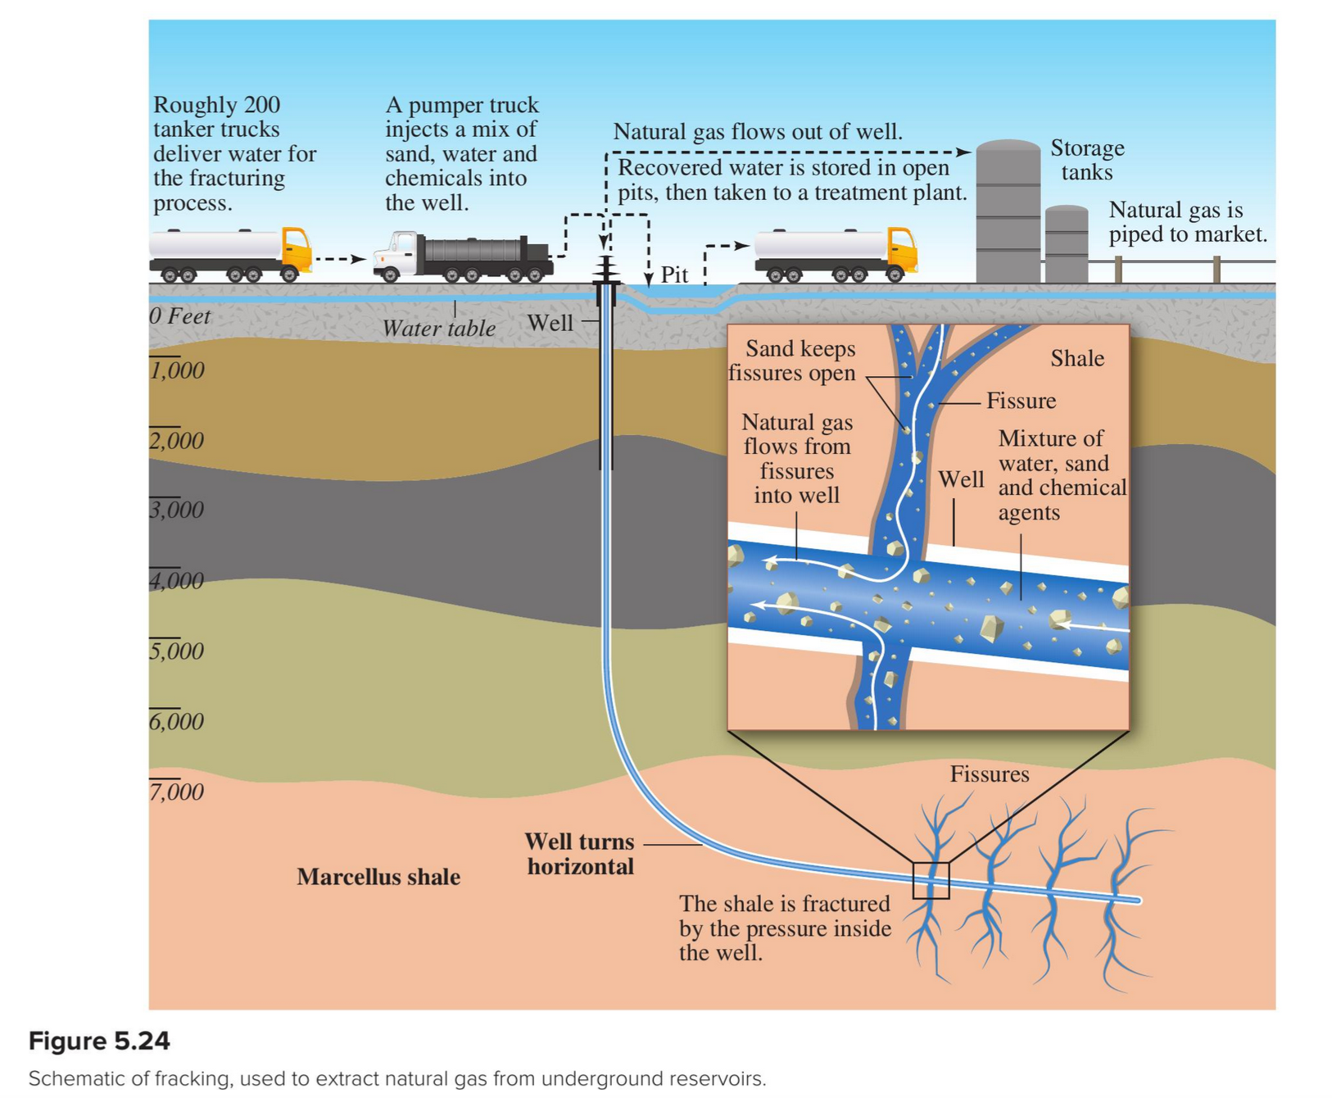
How to get it out of the ground: Fracking

Slide 11
Roadmap for today
Forms of fossil fuels (coal, oil, gas)
How we make electricity from burning fossil fuels (or anything else)
What burning has to do with chemical bonds
How we refine the oil we extract from the ground (for burning, and also to make plastics)
How we extract fossil fuels from the ground

Slide 12
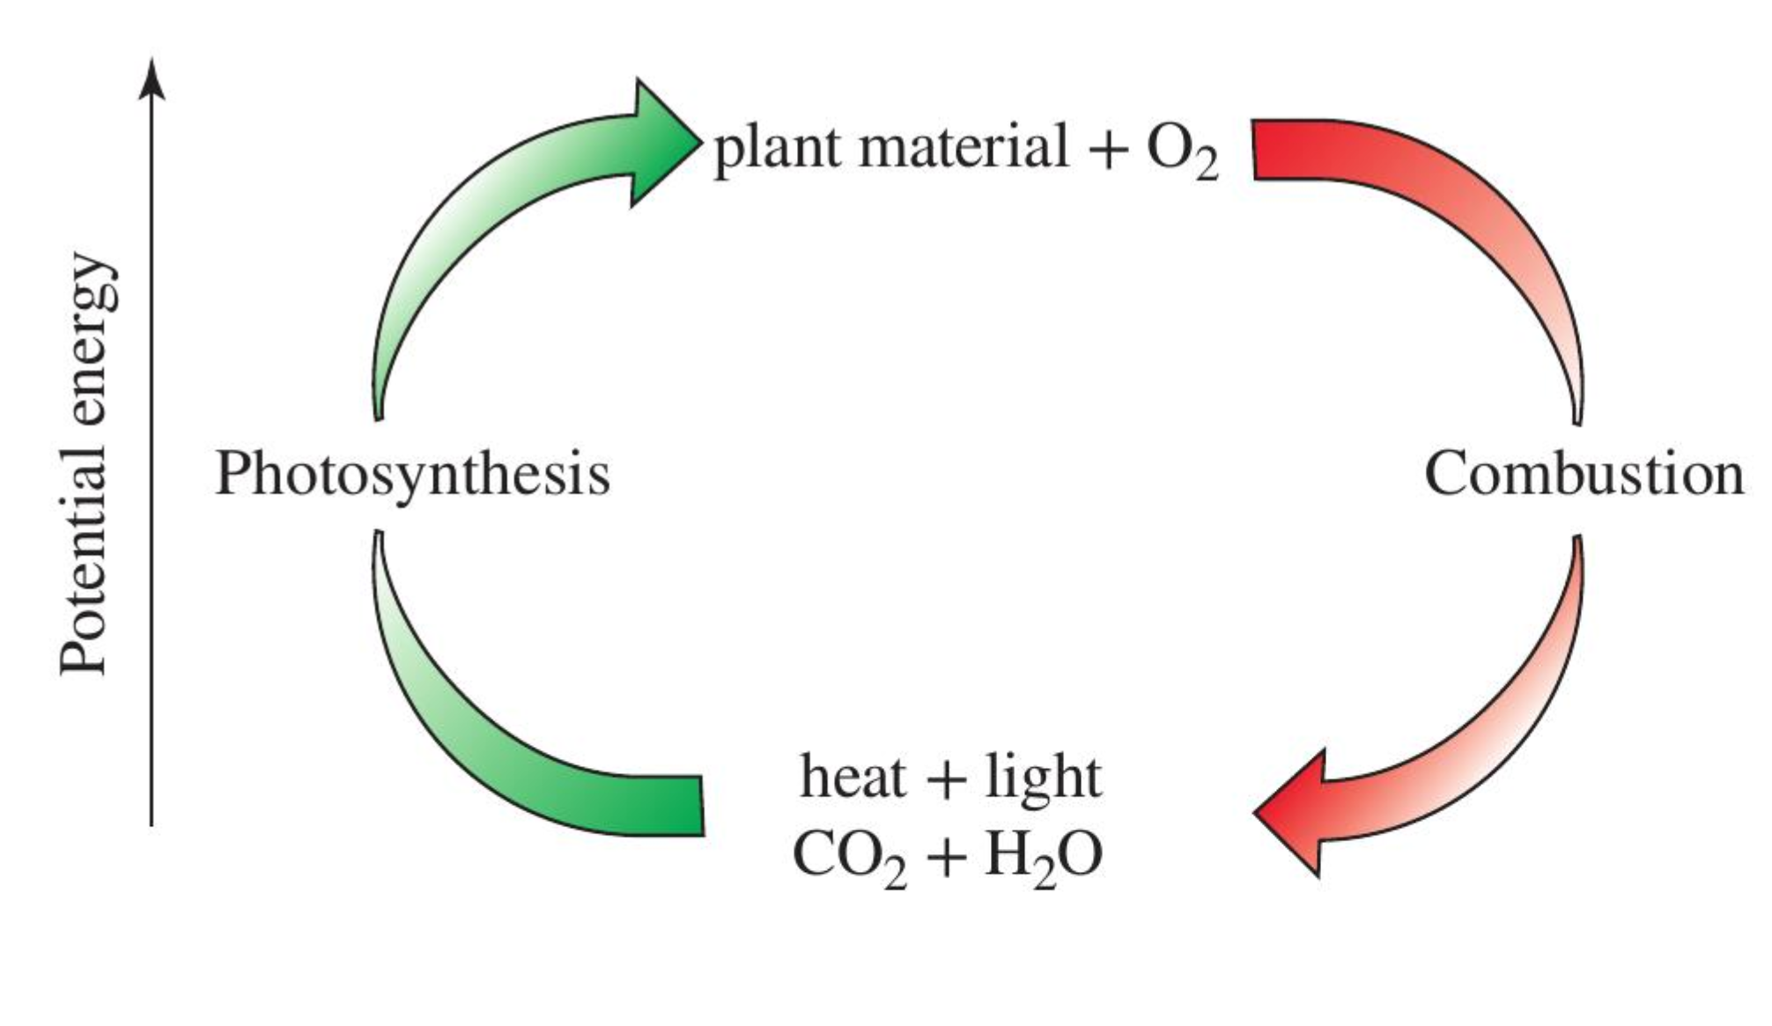
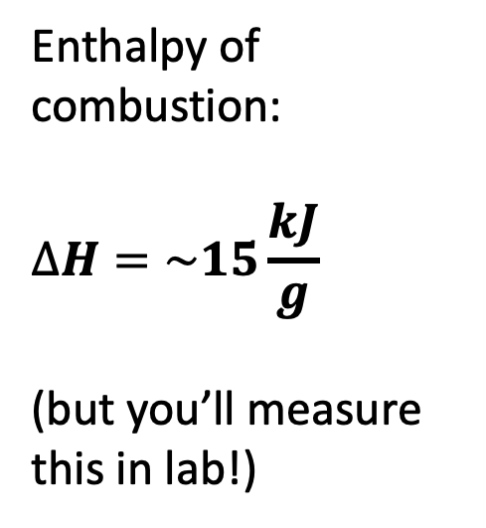
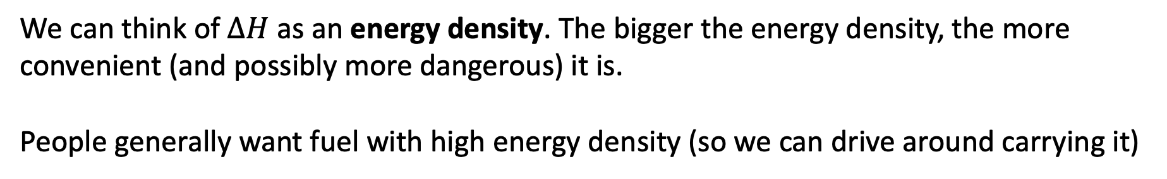
Idea of energy density
Enthalpy of combustion:
$$∆H=\sim 15\frac{kJ}{g}$$
(but you’ll measure this in lab!)
We can think of $∆H$ as an energy density. The bigger the energy density, the more convenient (and possibly more dangerous) it is.
People generally want fuel with high energy density (so we can drive around carrying it)

Slide 13
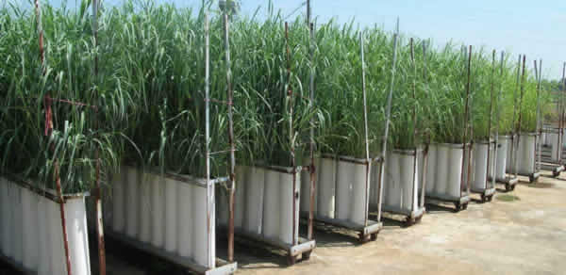
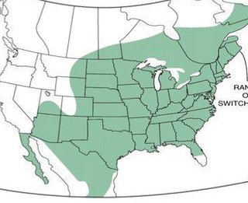



Some high-producing biofuels
Switchgrass
Fruit
Corn
Sugarcane

Slide 14
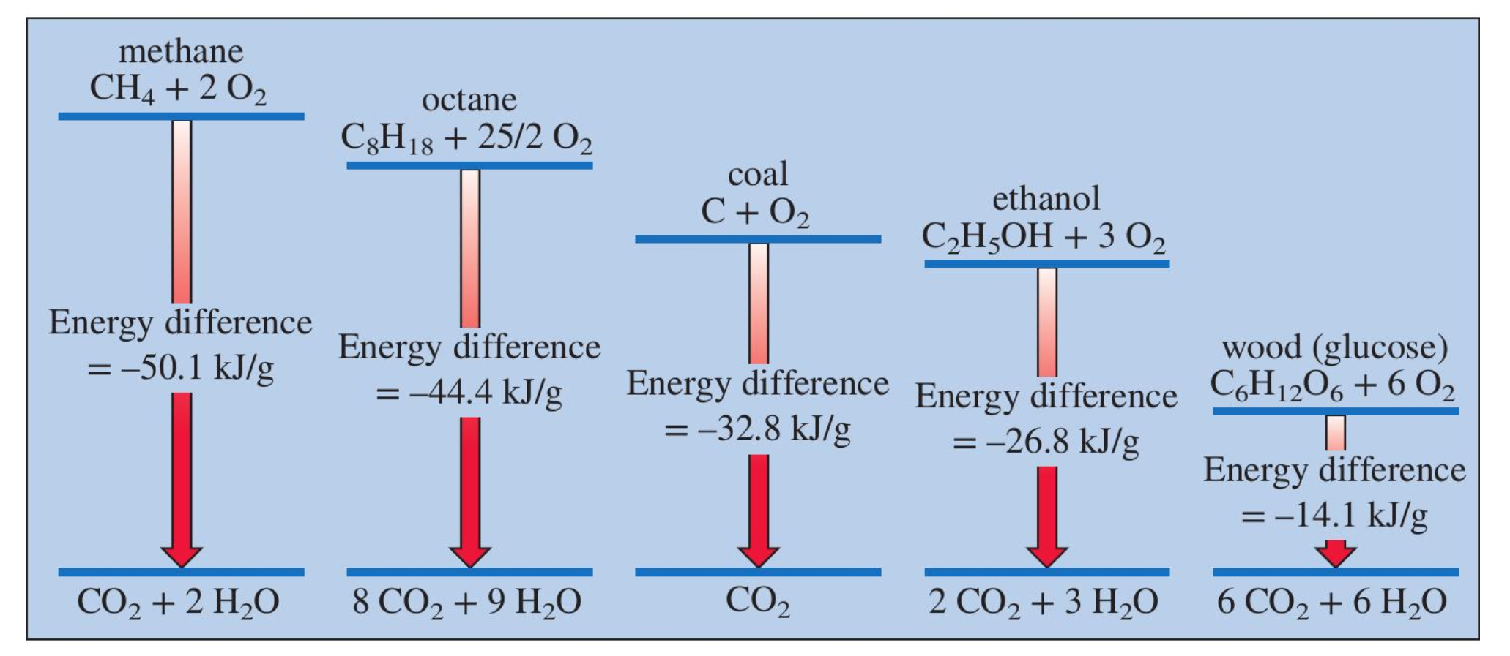
Increasing the energy density
Ferment the glucose or other photosynthetic products (wood, grass)

Slide 15
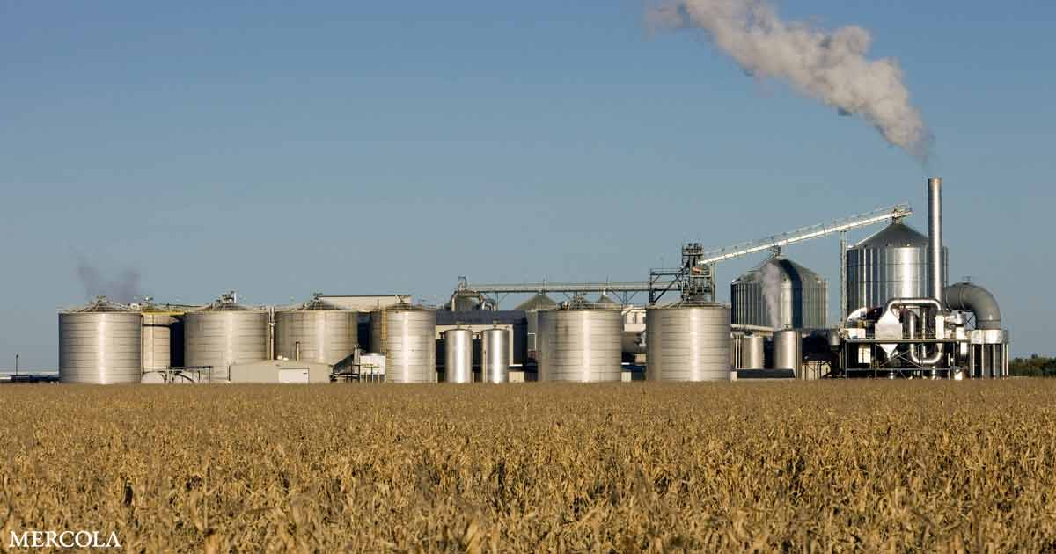
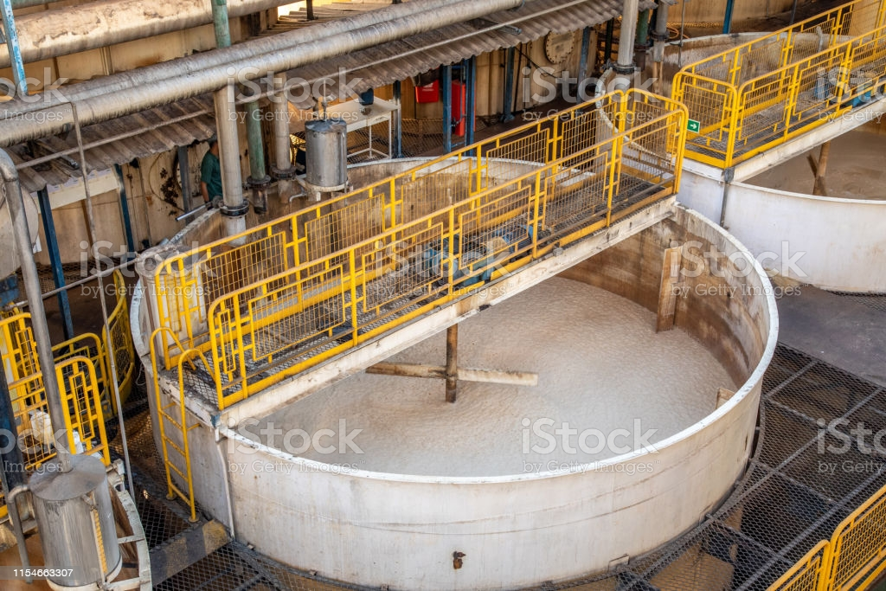
We can ferment sugars, carbohydrates, and cellulosic (leafy) parts

Slide 16
Ethanol is a little higher up on the energy density scale

Slide 17



We can also extract vegetable oil from plants
Palm oil (Indonesia)

Slide 18
Vegetable oil is a little higher up on the energy density scale

Slide 19
Then there’s fossil fuels
Photosynthetic products that have been processed by high heat and pressure underground

Slide 20
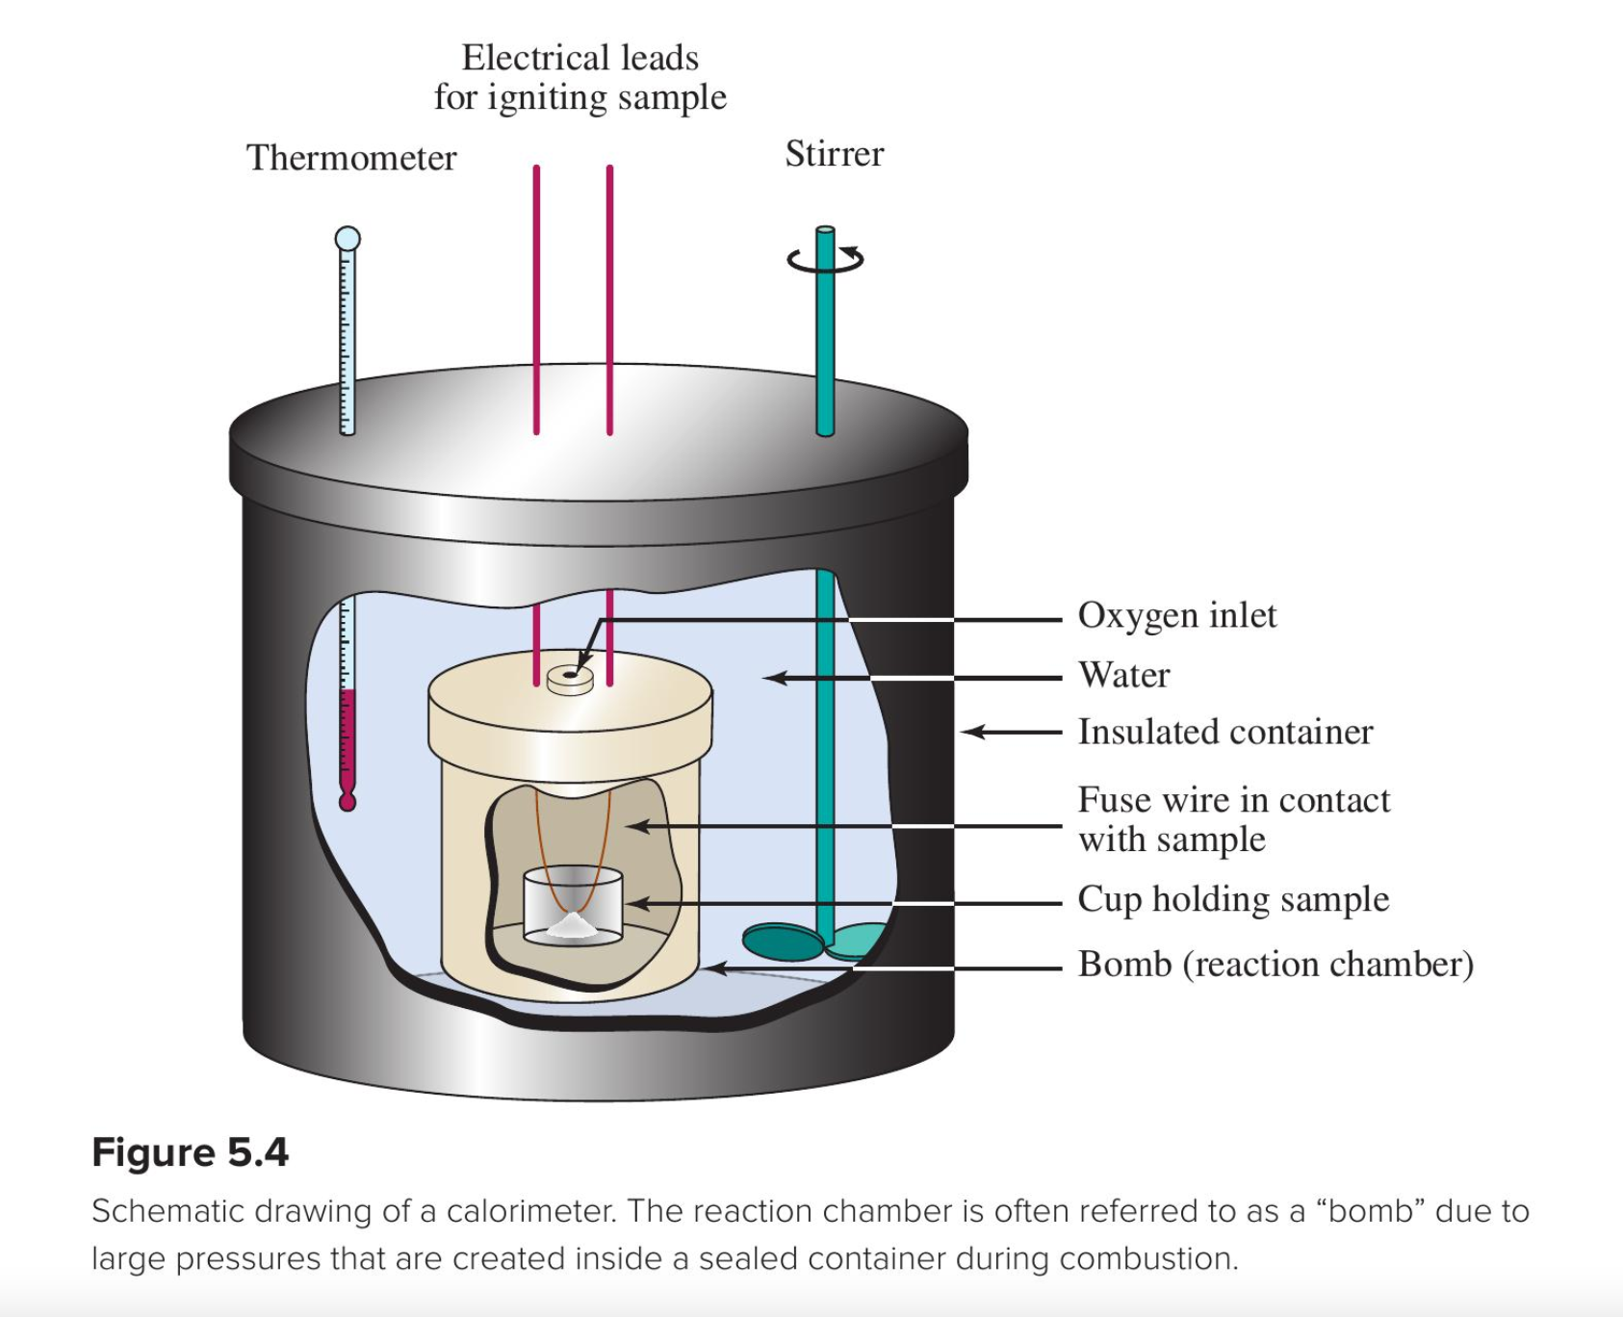
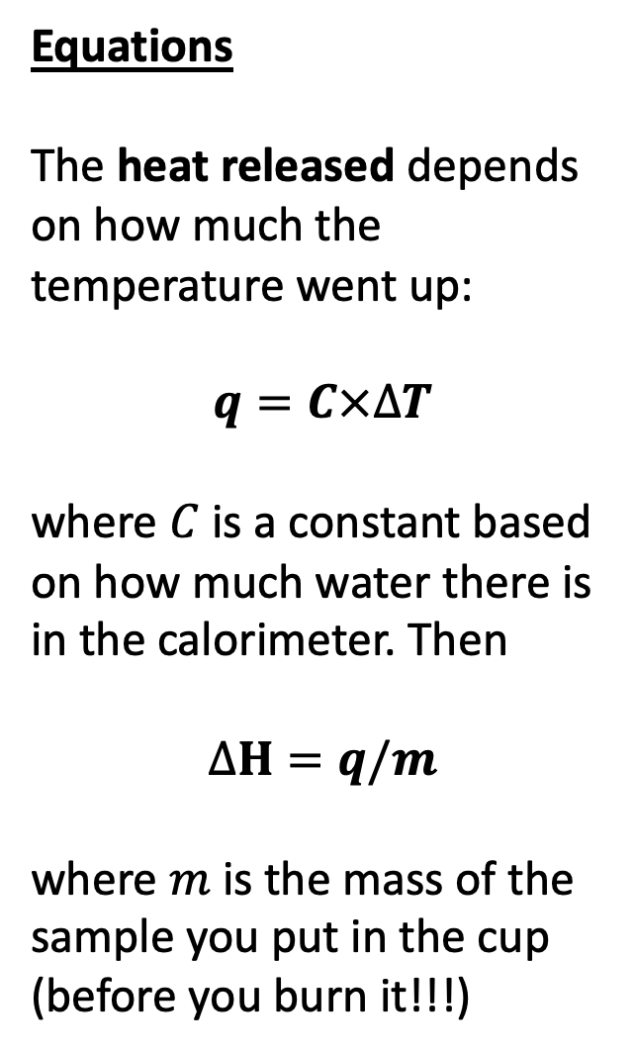
How do we know those numbers?
Equations
The heat released depends on how much the temperature went up:
$$q=C×∆T$$
where $C$ is a constant based on how much water there is in the calorimeter. Then
$$∆H=q/m$$
where $m$ is the mass of the sample you put in the cup (before you burn it!!!)
Bomb calorimeter
(lab)

Slide 21
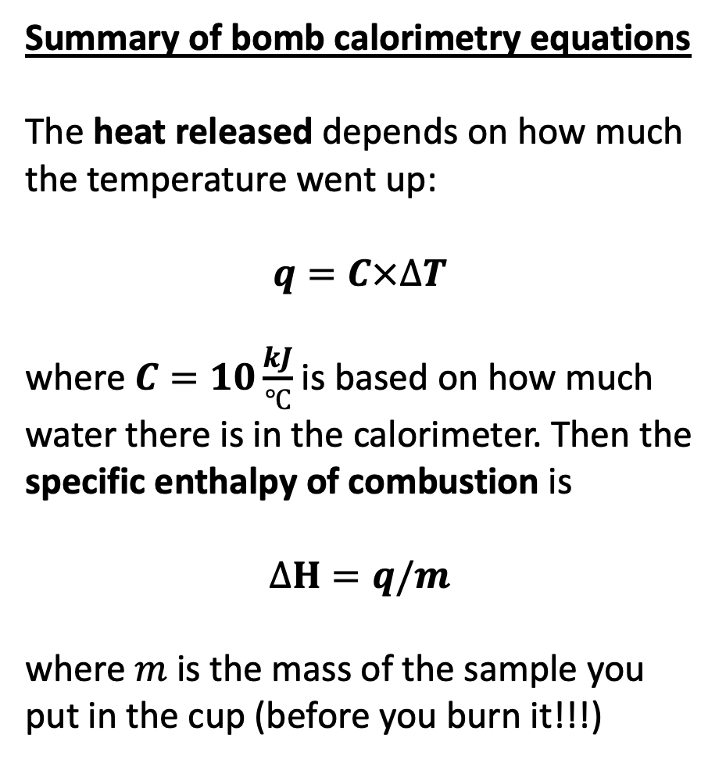
Measuring vs getting info from labels
Summary of bomb calorimetry equations
The heat released depends on how much the temperature went up:
$$q=C×∆T$$
where $C=10\frac{kJ}{℃}$ is based on how much water there is in the calorimeter. Then the specific enthalpy of combustion is
$$∆H=q/m$$
where $m$ is the mass of the sample you put in the cup (before you burn it!!!)
Summary of nutrition equations
1 Calorie = 1 kcal = 1000 calories
1 kcal = 4.18 kJ
The specific enthalpy of combustion (or digestion) is the energy per serving divided by the grams per serving.
Your task … what’s the fuel with the highest specific enthalpy of combustion (also called energy density): wood pellets, cooking oil, or option #3? How do they compare with fossil fuels?

